Slide 1
Test Driven Development with InSpec on Azure

Slide 2
Test Driven Development
Define a test set for the unit first
Then implement the unit
Finally verify that the implementation of the unit makes the tests succeed.
Refactor
Notes:
Test Driven Development (TDD) is a workflow that asks you to perform that act continually and repeatedly as you satisfy the requirements of the work you have chosen to perform.
TDD generically focuses on the unit of software any level. It is the process of writing the test first, implementing the unit, and then verifying the implementation with the test that was written.
A 'unit' of software is purposefully vague. This 'unit' is definable by the individuals developing the software. So the size of a 'unit of software' likely has different meanings to different individuals based on our backgrounds and experiences.

Slide 3
Discuss Requirements
Requirements for a web server

Slide 4
Discuss Requirements
Install the Apache package, httpd, on Red Hat
Start and enable the httpd service.
Serve a custom home page.
Open port 80 to incoming traffic.

Slide 5
Create Cookbook & First Test
Generate cookbook with chef
Write First Test in Inspec

Slide 6
Create Cookbook
> chef generate cookbook webserver
Generating cookbook webserver_test
- Ensuring correct cookbook file content
Committing cookbook files to git
Ensuring delivery configuration
Ensuring correct delivery build cookbook content
Adding delivery configuration to feature branch
Adding build cookbook to feature branch
Merging delivery content feature branch to master
Your cookbook is ready. Type `cd cookbooks/webserver_test` to enter it.
...
Notes:
We can examine the contents of the cookbook that chef generated for us. Here you see that the tool created for us a complete test directory structure.

Slide 7
Inspec Test
describe '<entity>' do
it { <expectation> }
end

Slide 8
Replace Spec File in Cookbook
~/webserver/test/smoke/default_test.rb
describe package 'httpd' do
it { should be_installed }
end
Notes:
The generator created an example specification (or spec) file. Before we talk about the RSpec/InSpec language lets explain the long file path and its importance.

Slide 9
Setup Testing on Azure
Install kitchen-azurerm gem
Create Azure Service Account
Configure Test Kitchen

Slide 10
Install kitchen-azurerm
> chef gem install kitchen-azurerm

Slide 11
Create Azure Service Account
az login

Slide 12
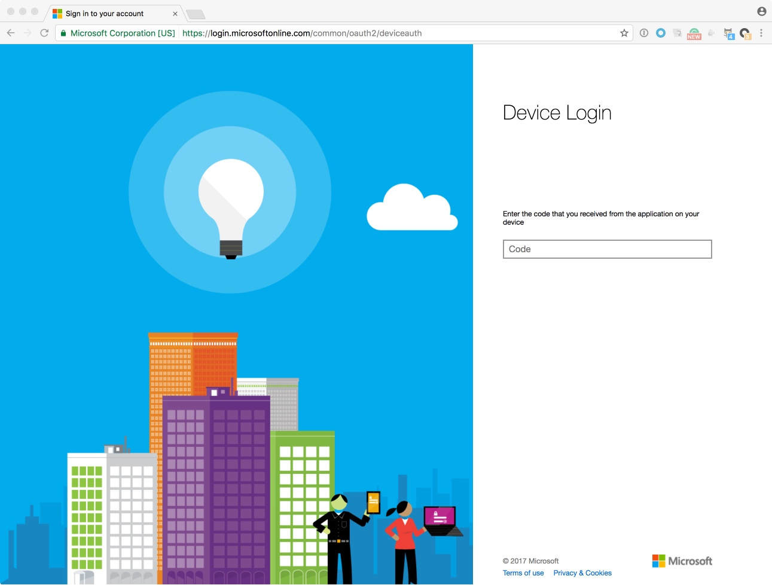
Create Azure Service Account
Steps
Go to https://aka.ms/devicelogin
Enter Code
Click Continue
Login to Azure
Close Browser Window
Notes:
To get started with Hosted Chef Server, visit the Chef website and sign up for a Hosted Chef Account.

Slide 13
Create Azure Service Account
> az ad sp create-for-rbac --name testkitchen --password ”<pass>"
{
"appId": ”GUID",
"displayName": "testkitchen",
"name": "http://testkitchen",
"password": ”<pass>",
"tenant": ”GUID”
}

Slide 14
Create Azure Service Account
~/.azure/credentials
[abcd1234-YOUR-SUBSCRIPTION-ID-HERE-abcdef123456]
client_id = "48b9bba3-YOUR-GUID-HERE-90f0b68ce8ba"
client_secret = "your-client-secret-here"
tenant_id = "9c117323-YOUR-GUID-HERE-9ee430723ba3"

Slide 15
Configure Test Kitchen
~/webserver/.kitchen.yml
Content: https://tinyurl.com/kitchenyml

Slide 16
Configure Test Kitchen
> kitchen list
Instance Driver Provisioner Verifier Transport Last Action Last Error
default-centos-72 Azurerm ChefZero Inspec Ssh <Not Created> <None>

Slide 17
Configure Test Kitchen
~/webserver/metadata.rb
name 'webserver’
maintainer 'The Authors’
maintainer_email 'you@example.com’
license 'all_rights’
description 'Installs/Configures webserver’
long_description 'Installs/Configures webserver’
version '0.1.0’
depends 'line'

Slide 18
Configure Test Kitchen
~/webserver/recipes/fixsudo.rb
delete_lines 'remove requiretty from sudoers' do
path '/etc/sudoers’
pattern '^.*requiretty’
end
http://tinyurl.com/chefsudofix

Slide 19
Run tests and see them fail
> kitchen verify
System Package
∅ httpd should be installed
expected that `System Package httpd` is installed
Test Summary: 0 successful, 1 failures, 0 skipped

Slide 20
Just Enough Recipe to Pass Test
~/webserver/recipes/default.rb
# Install the Apache package.
package 'httpd'

Slide 21
Just Enough Recipe to Pass Test
> kitchen converge && kitchen verify
System Package
✔ httpd should be installed
Test Summary: 1 successful, 0 failures, 0 skipped
Finished verifying <default-centos-72> (0m2.94s).

Slide 22
Remaining Requirements
Install the Apache package, httpd, on Red Hat
Start and enable the httpd service.
Serve a custom home page.
Open port 80 to incoming traffic.
http://inspec.io/docs

Slide 23
Remaining Requirements
~/webserver/test/smoke/default_test.rb
describe package 'httpd' do
it { should be_installed }
end
describe service 'httpd' do
it { should be_enabled }
it { should be_running }
end
describe command 'curl localhost' do
its('stdout') { should match /hello/ }
end
describe port 80 do
it { should be_listening }
end
Notes:
The generator created an example specification (or spec) file. Before we talk about the RSpec/InSpec language lets explain the long file path and its importance.

Slide 24
Remaining Requirements
> kitchen verify
System Package
✔ httpd should be installed
Service httpd
∅ should be enabled
expected that `Service httpd` is enabled
∅ should be running
expected that `Service httpd` is running
Command curl
∅ localhost stdout should match /hello/
expected "" to match /hello/
Diff:
@@ -1,2 +1,2 @@
-/hello/
+"”
Port 80
∅ should be listening
expected `Port 80.listening?` to return true, got false
Test Summary: 1 successful, 4 failures, 0 skipped

Slide 25
Remaining Requirements
~/webserver/recipes/default.rb
# Install the Apache package.
package 'httpd’
# Start and enable the httpd service.
service 'httpd' do
action [:enable, :start]
end
# Serve a custom home page.
file '/var/www/html/index.html' do
content '<html>
<body>
<h1>hello world</h1>
</body>
</html>’
end

Slide 26
Remaining Requirements
> kitchen converge && kitchen verify
System Package
✔ httpd should be installed
Service httpd
✔ should be enabled
✔ should be running
Command curl
✔ localhost stdout should match /hello/
Port 80
✔ should be listening
Test Summary: 5 successful, 0 failures, 0 skipped
Finished verifying <default-centos-72> (0m3.50s).

Slide 27
Remaining Requirements
> kitchen test
Test Summary: 5 successful, 0 failures, 0 skipped
Finished verifying <default-centos-72> (0m3.50s).

Slide 28
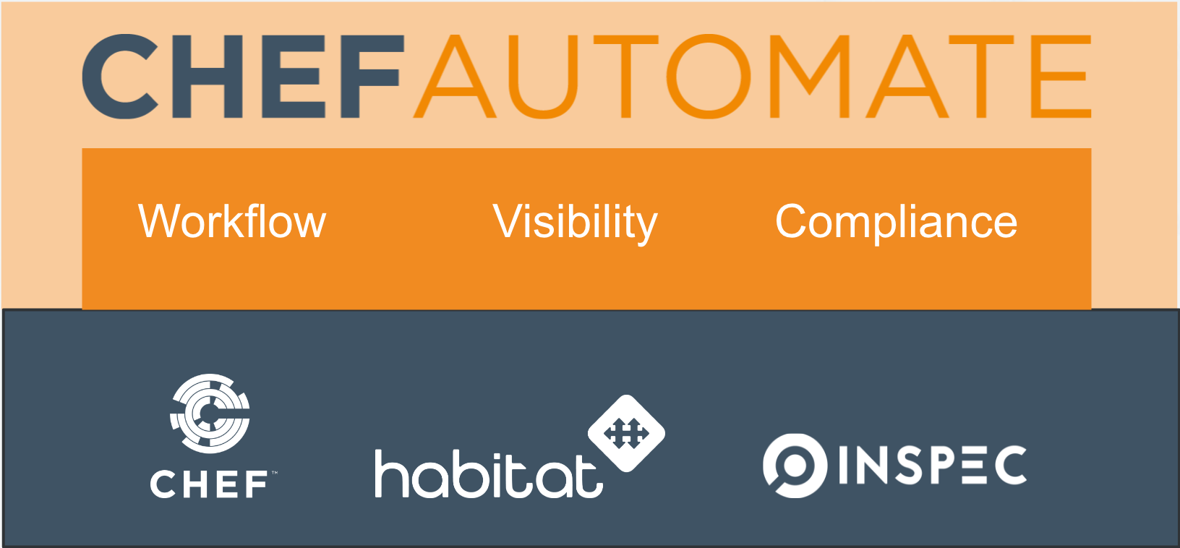
Notes:
Chef now has a single product: Automate and when you buy Chef you get access to all the tools to help you succeed.
The constituents of this product are:
Workflow – A delivery pipeline for your infrastructure cookbooks and application code.
Visibility – an overview of your chef controlled estate and a pane of glass as to how your chef estate is working.
Compliance – checking your infrastructure conforms to standards you want it to, either self authored profiles or from our library of standards.
Habitat is an application automation too which is made up of two components:
- A packing tool which pulls in all the dependencies for an application; that could be some web scale applications or legacy non-web specific products. The output is a single binary which runs on a node without worrying about the underlying infrastructure (currently Linux only).
- It is also a supervisor which allows you to control deployments of multiple ‘instances’ and have them working together in synergy.
Inspect is a high level language for testing of infrastructure, it is (easily) human and machine readable and underpins compliance and other tests within the chef ecosystem.

